Slide 1
MLSA Full Stack Web Development Internship Report
Name - KANISHK KUMAR
University Roll No. - 2300290100131
Section - B
Branch - CSE(2023-27)

Slide 2

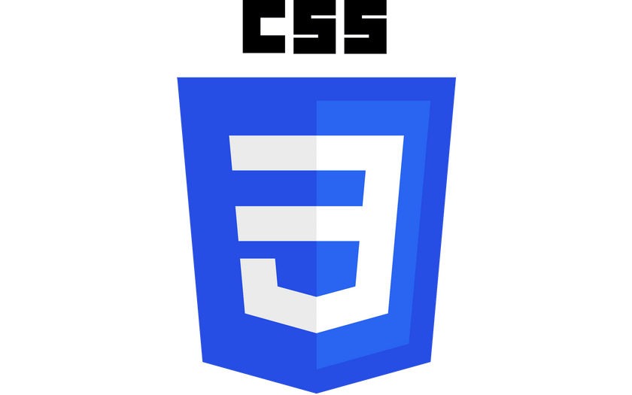

Tech Stack Used
Hyper Text Markup Language (HTML) is used for providing the structure to the website . It contain all the data which we want to display on our website.
CSS is known as of “Cascading Style Sheets”. It is used to make our website presentable. We can link the CSS to our html using Link tag. We have three types of CSS available-Internal , External and Inline.
JavaScript is a scripting language is used to make our website working . It helps us in updating content, controlling multimedia ,etc.

Slide 3
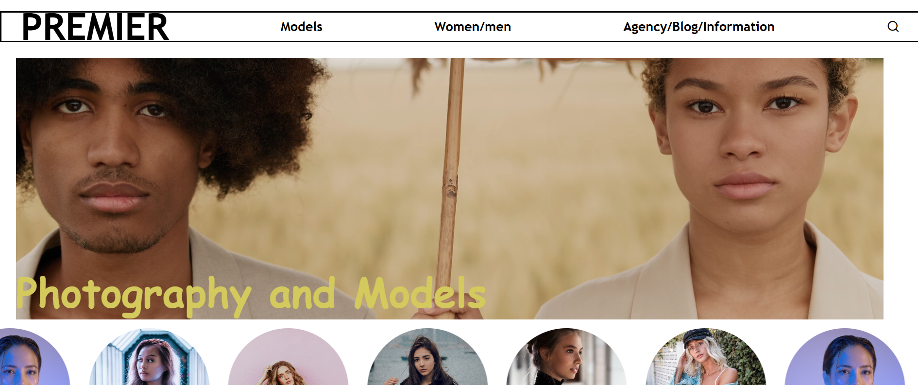
EASY PROJECT – A WEBSITE

Slide 4


Slide 5
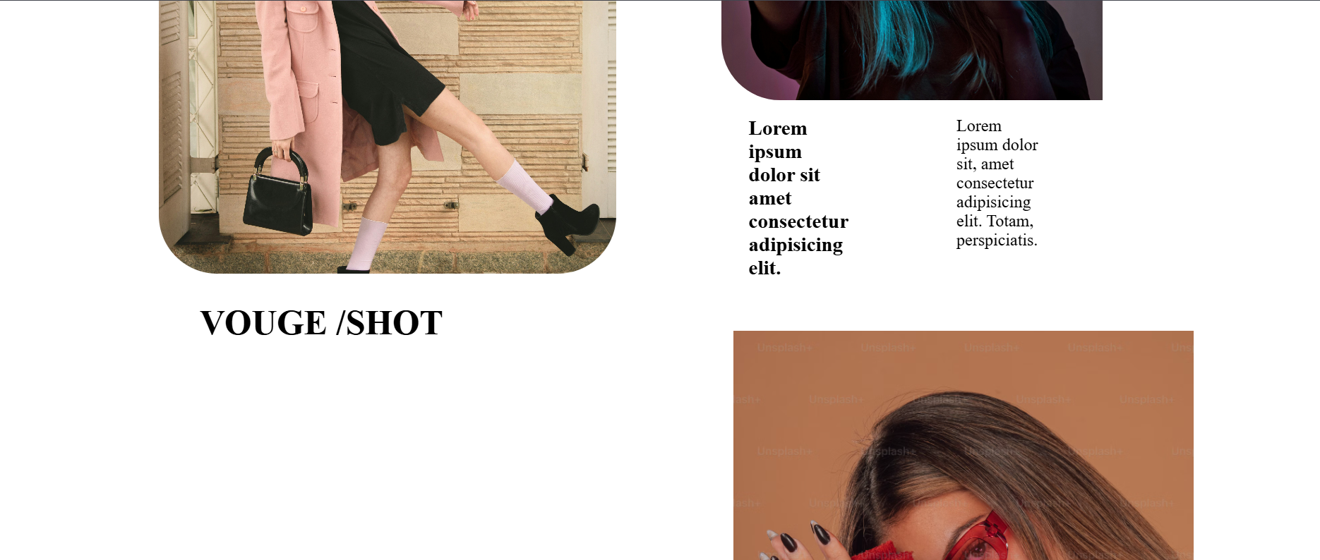

Slide 6
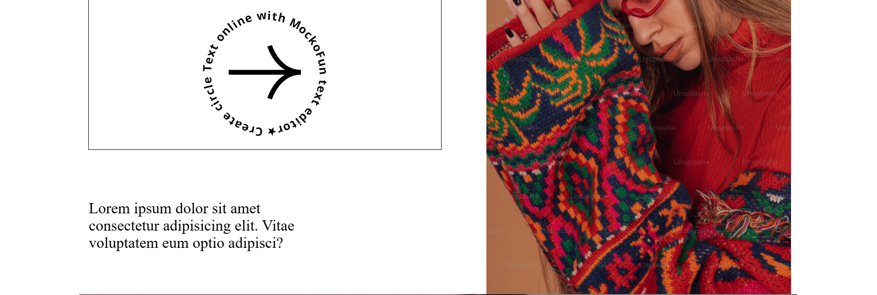

Slide 7
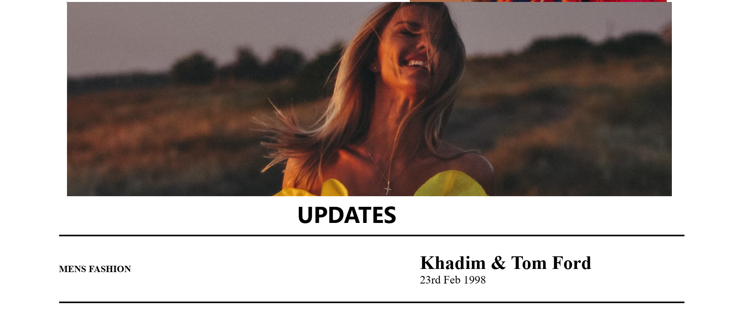

Slide 8
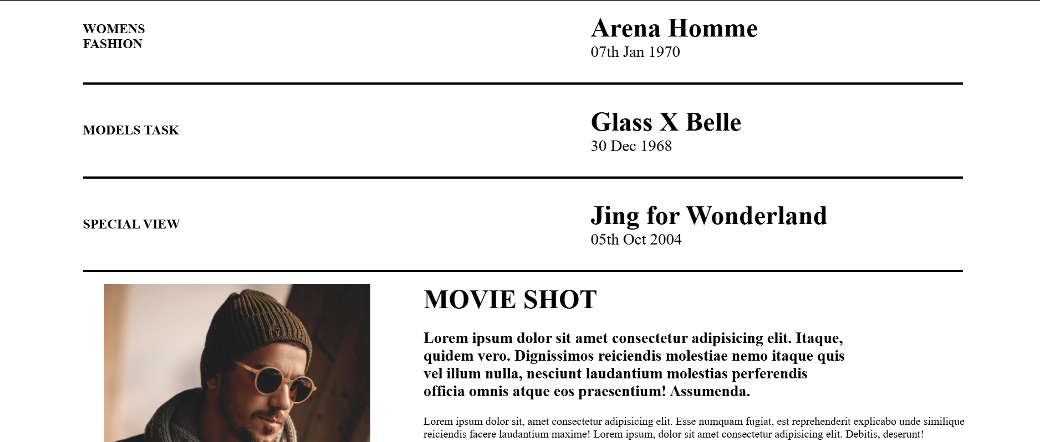

Slide 9
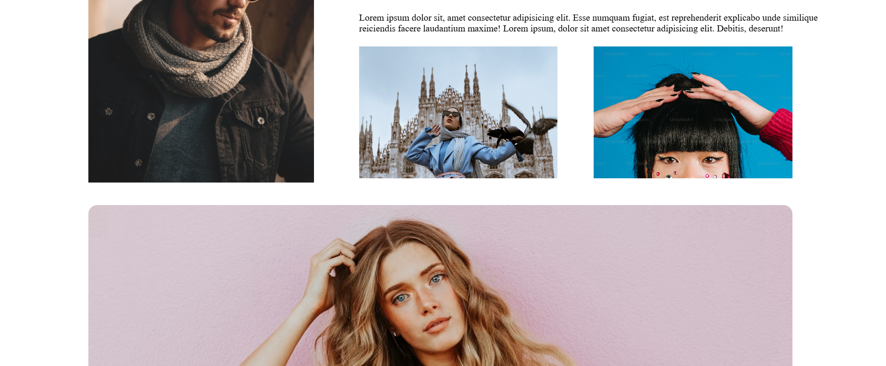

Slide 10
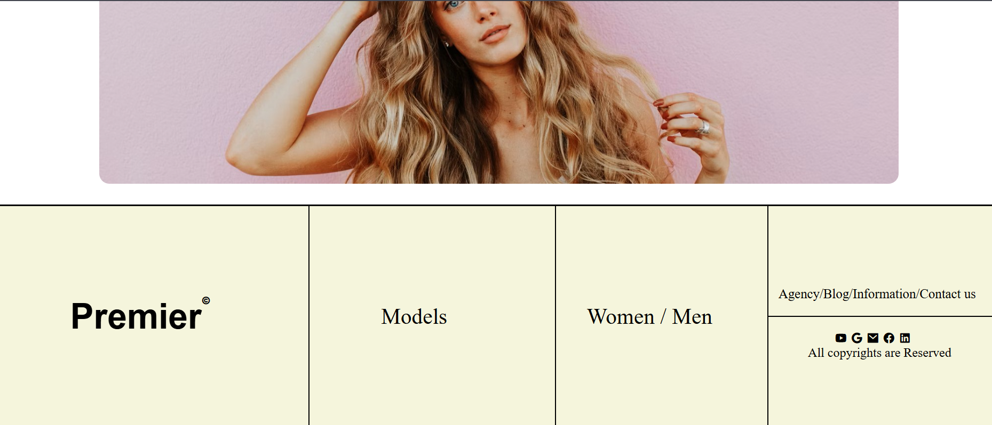

Slide 11
Websites Feature
This is a website which is made to text my skills.
I have used many concept of HTML,CSS and JavaScript .

Slide 12
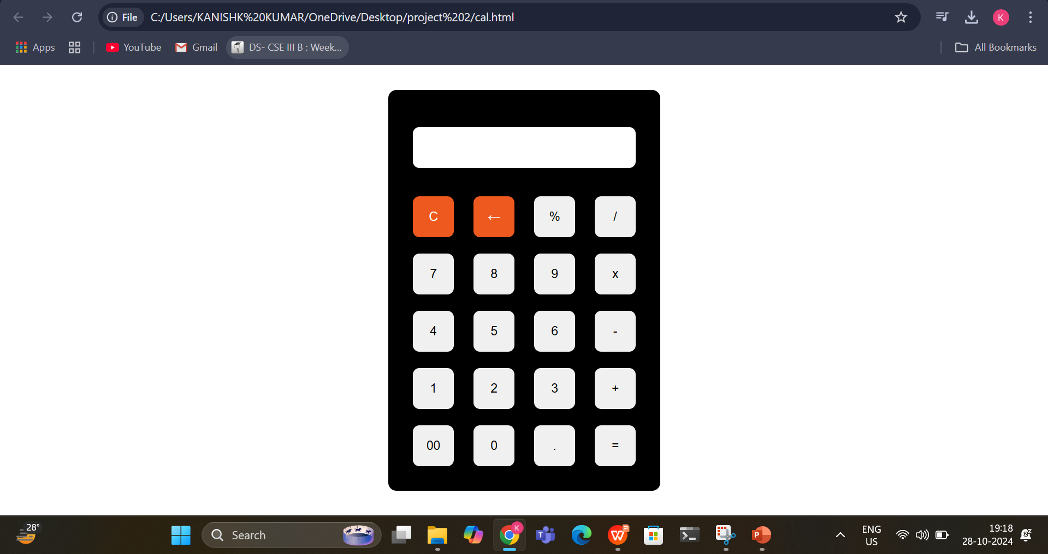
Intermediate Project : Calculator

Slide 13
CALCULATOR FEATURES
It is a basic calculator which is used to perform basic calculations.
It contains buttons which have numbers and operations which we want to perform .
We give input using buttons and then press ‘=’ to get the result.
After getting the result we can clear the display using ‘C’ for further calculations.
It takes input using keyboard keys to only numeric ones works.

